Slide 1
Reporting Using Libpas
Paul Andrews
PLNZ Data Analyst

Slide 2
Overview
What data is available
Interactive demonstration of the Libpas reporting feature

Slide 3
Libpas Structure
PLNZ National Data Collection (population, issues, visits, collection size, etc)
Benchmark Data (number of libraries, reading programmes, opening hours, fines)
Staffing
Library Services (Events and attendance)
Expenditures & Revenue
KPI Measures (Visits per registered borrower, Total Circulation per capita, Staff Expenditures per capita, etc.)

Slide 4
Using Libpas Reports
Reporting allows you to create any report using any combination of PI’s (performance indicators)
Compare your library to:
All libraries
a group of similar libraries to your library based on any data field
either as a percentage of your library
or with a range
or using the region field
A group of libraries you manually select, such as geographically adjacent libraries

Slide 5
Using Libpas Reports
Reports can be viewed or printed on the screen either in a table, some graphs or exported to Excel
There is a diverse range of reports available allowing you to show:
A single year
Trends across years
Graphs
Ability to export to excel to customise the output

Slide 6
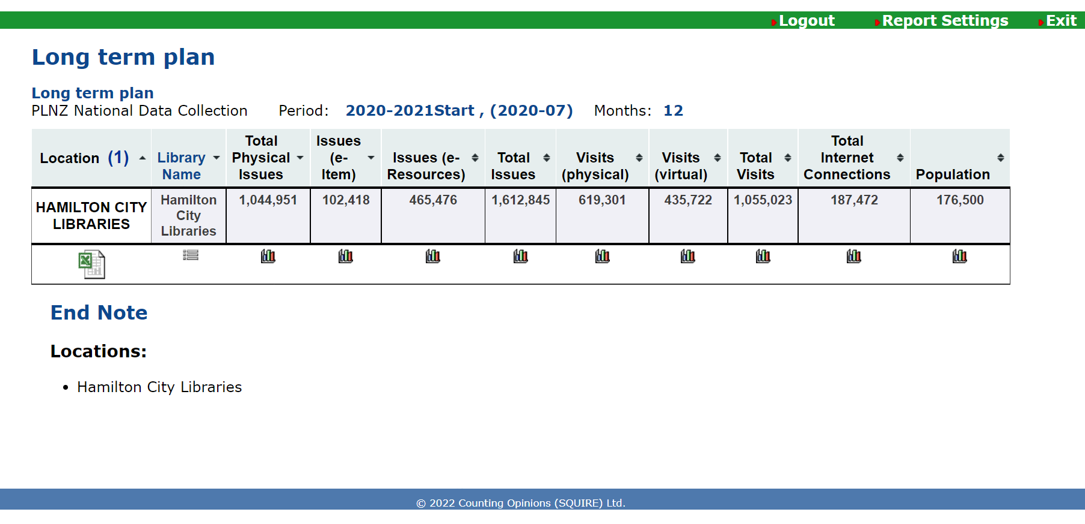
Table report example – Long Term Plan
Notes:
A sample of some data that could be used in a Long tern plan.
The report type is a Table.
The report has been restricted to one library.
The pink highlight indicates that is your library.
Clicking on the Excel icon will save the report to an Excel file.

Slide 7
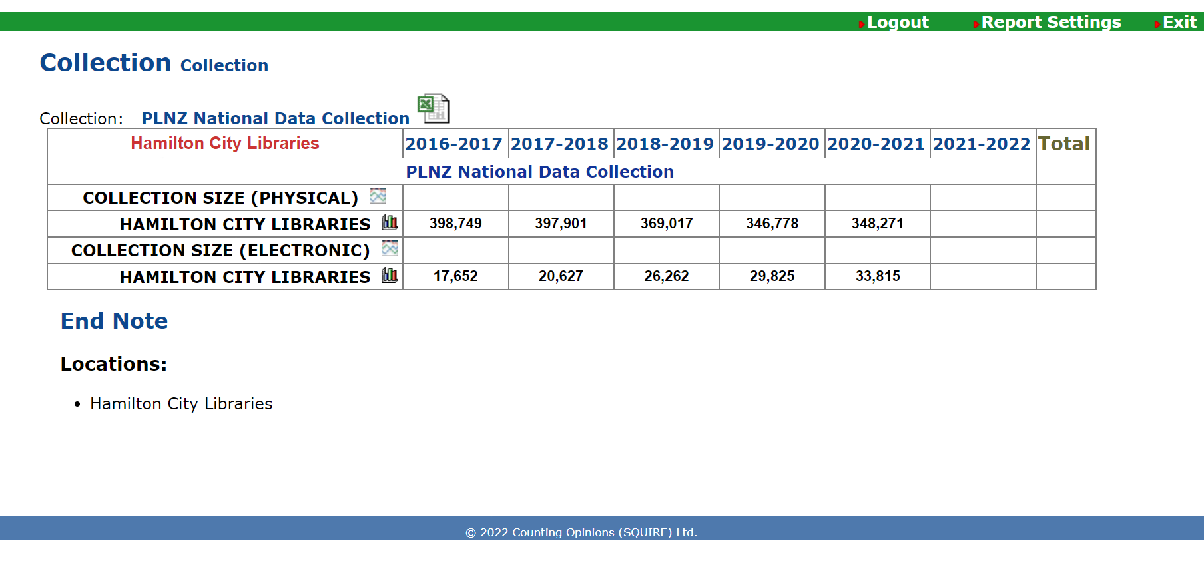
Trend report example – Collection
Notes:
A staffing report for all libraries.
To display all the libraries on the screen at once change the number at the bottom to the maximum.
Even if only some libraries are displayed all the information will be exported to Excel.

Slide 8
How to create a report in Libpas

Slide 9
If you have any questions about LibPAS please contact Paul using either
data@publiclibraries.org.nz
028 464 8112
If you would like the data for all libraries for all years in an Excel format please let me know.

